Slide 1
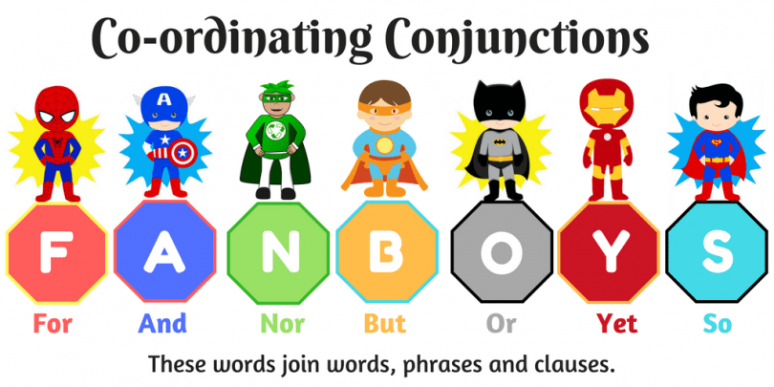

Slide 4

What do you know about FANBOYS?

Slide 5
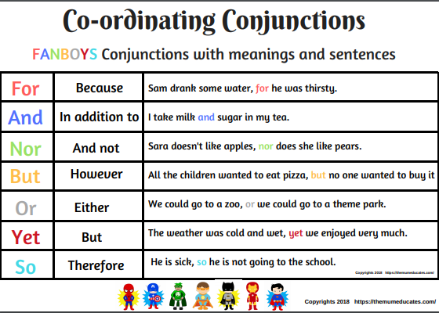
I want to pass the exam, and I want to get high score.

Slide 6
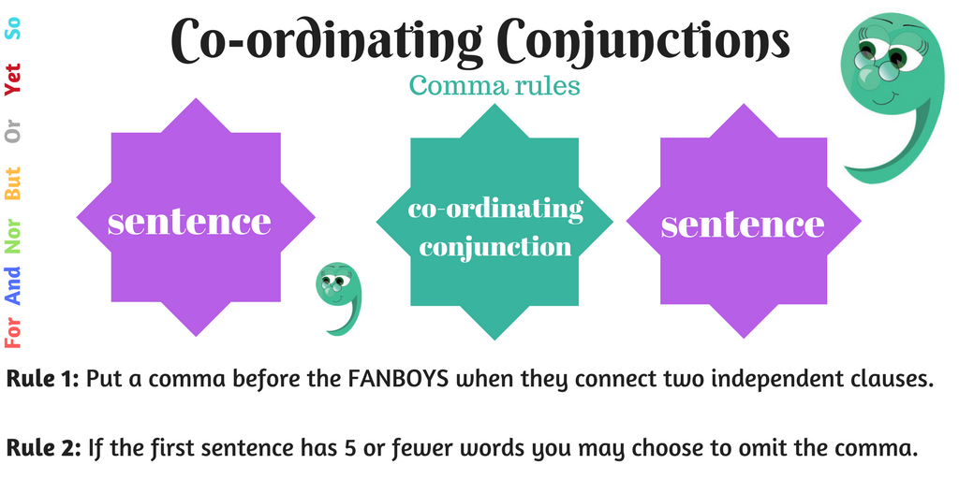

Slide 7
Question 1: Which of the following sentences is a compound sentence?
1. I went to the store, but I didn't buy anything.
2. The dog barked, and the cat ran away.
3. The children played in the park.

Slide 8
Question 2: Which of the following sentences is not a compound sentence?
1. I went to the store, and I bought some groceries.
2. The cat ran away, but the dog stayed.
3. The children played in the park and had a lot of fun.

Slide 9
Question 3: Rewrite the following sentence as a compound sentence: The dog barked. The cat ran away.
Answer:
The rewritten sentence is:
The dog barked, and the cat ran away.

Slide 10

It is your turn to give examples.

Slide 11


Slide 12


